Slide 1
Comparative analysis of max-flow algorithms
Jiaming Yu

Slide 2
Goal
(1) Implement preflow-pusn algorithms with different versions and Edmonds–Karp algorithm
(2) Select input files with different size and evaluate the performance of the above algorithm(explore the relationship between complexity and V,E)

Slide 3
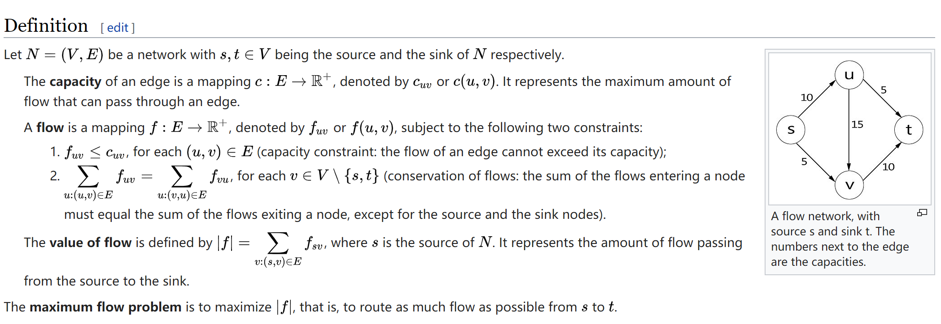
Idea
Max-flow problem(finding a feasible flow through a flow network that is maximum)
Push–relabel maximum flow algorithm: two operations(push and relabel), different versions like with FIFO vertex selection rule and with dynamic trees
Edmonds–Karp algorithm:identical to the Ford–Fulkerson algorithm, except that the search order when finding the augmenting path is defined

